Slide 1
Properties of Z transform

Slide 2
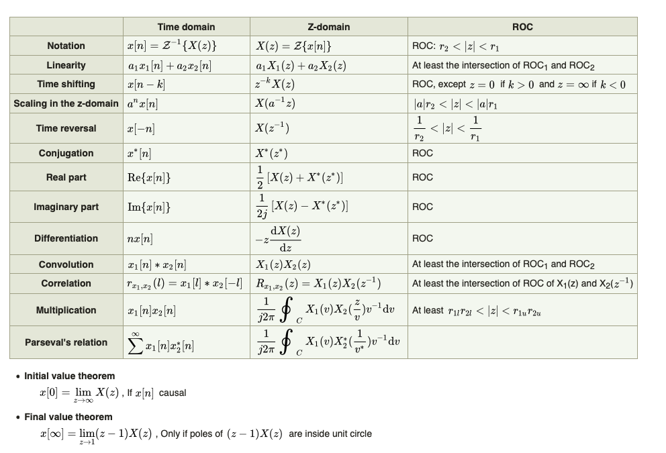

Slide 3
Final value theorem is used for:
All type of systems
Stable systems
Unstable systems
Marginally stable systems

Slide 4
b

Slide 5
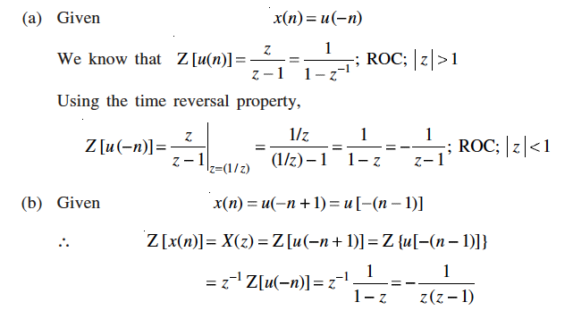
Find the z transform using properties of z transform

Slide 6
Which of the following justifies the linearity property of z-transform?[x(n)↔X(z)].
a)x(n)+y(n)↔X(z)Y(z) b) x(n)+y(n) ↔ X(z)+Y(z) c) x(n)y(n) ↔ X(z)+Y(z) d) x(n)y(n) ↔ X(z)Y(z)

Slide 7
b

Slide 9
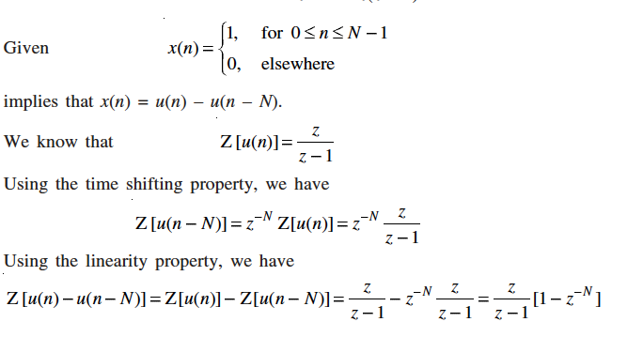
Find the z transform using properties of z transform

Slide 10
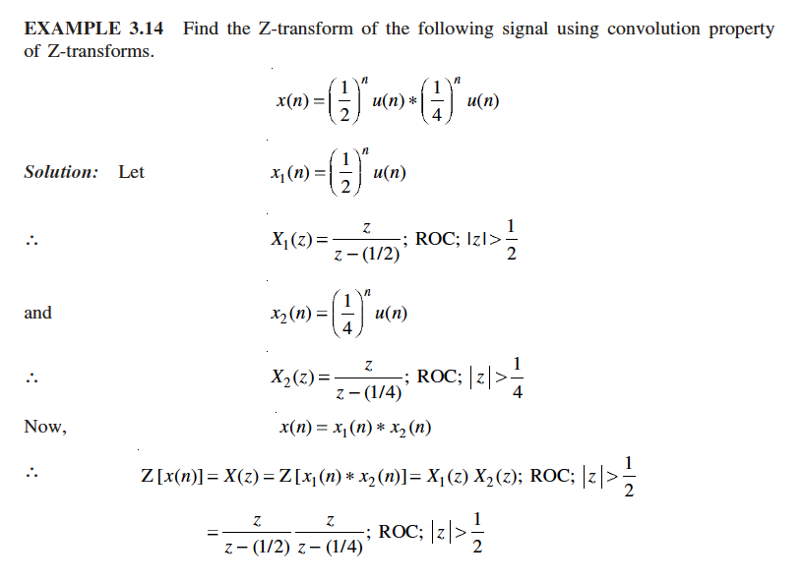

Slide 11
What is the z-transform of the signal x(n)=[3(2^{n})-4(3^{n})]u(n)?
a) 3/ (1−2𝑧⁻¹)- 4/(1−3𝑧⁻¹ ) b) 3/(1−2𝑧⁻¹) -4/ (1+3𝑧⁻¹ ) c) 3/ (1−2𝑧)− 4/ (1−3𝑧) d) None of the mentioned

Slide 12
a

Slide 13
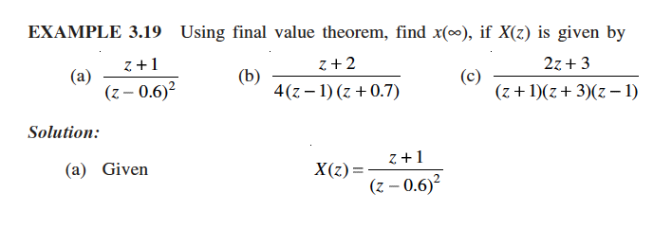

Slide 14
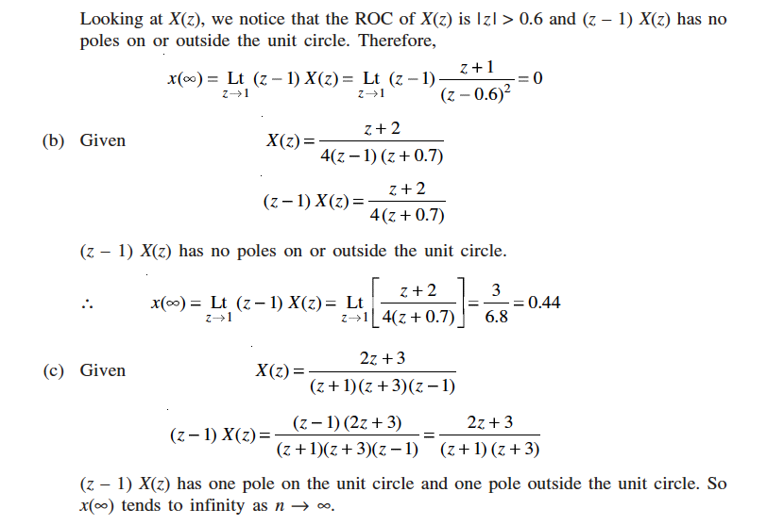

Slide 15
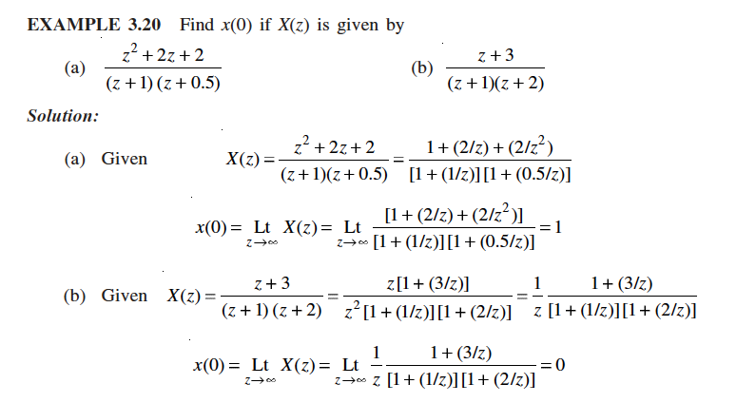

Slide 16
According to Time shifting property of z-transform, if X(z) is the z-transform of x(n) then what is the z-transform of x(n-k)?
a) z^{k}X(z) b) z^{-k}X(z) c) X(z-k) d) X(z+k)

Slide 17
b

Slide 18
If X(z) is the z-transform of the signal x(n), then what is the z-transform of the signal x(-n)?
a) X(-z) b) X(z⁻¹) c) X⁻¹(z) d) None of the mentioned

Slide 19
b

Slide 20
X(z) is the z-transform of the signal x(n), then what is the z-transform of the signal nx(n)?
a) −𝑧𝑑𝑋(𝑧)/𝑑𝑧 b) 𝑧𝑑𝑋(𝑧)/𝑑𝑧 c) −𝑧⁻¹𝑑𝑋(𝑧)/𝑑𝑧 d) 𝑧⁻¹𝑑𝑋(𝑧)/𝑑𝑧

Slide 21
a

Slide 22
If X(z) is the z-transform of the signal x(n) then what is the z-transform of a^{n}x(n)?
a) X(az) b) X(az⁻¹) c) X(a⁻¹z) d) None of the mentioned

Slide 23
c

Slide 24
If Z{x₁(n)}=X₁(z) and Z{x₂(n)}=X₂(z) then Z{x₁(n)*x₂(n)}=?
a) X₁(z).X₂(z) b) X₁(z)+X₂(z) c) X₁(z)*X₂(z) d) None of the mentioned

Slide 25
a

